Slide 1

Hospital Readmission Prediction System Using LLM
Dr. Simon Shim
Data 298B Team 7
Team -
Mahesh Buragala
Sai Krishna Bhamidipati
Sreenidhi Polineni
Supraja Anagandula
Venkata Karthik Patralapati

Slide 2
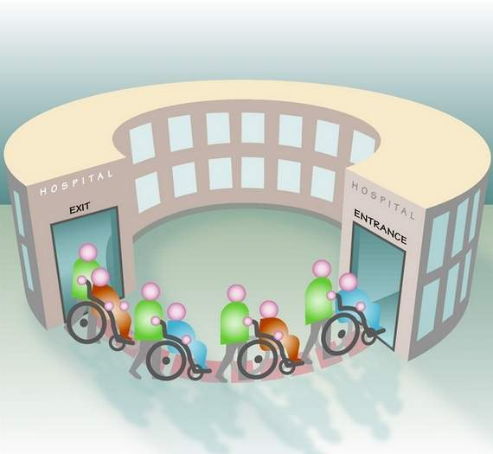
Presentation Chronology
I. Project Introduction, Motivation, Background, objectives and needs
II. Literature and Technology Survey
III. Data Engineering
IV. Machine Learning Modeling
V. Machine Learning Evaluation Results
VI. Web Portal System Development
VII. System Demo and Testing

Slide 3
Introduction
1. The project employs a Retrieval Augmented Generation (RAG) architecture that synergizes pre-trained models with expansive data stores to enhance prediction accuracy.
2. The RAG framework starts with a retriever component that sources documents closely related to the initial input from the data store, setting the stage for accurate predictions and relevant information generation.
3. It utilizes state-of-the-art NLP techniques and Large Language Models (LLMs) including ClinicalBERT, Mistral, Llama Series and BioMistral, enhancing the system's capability to interpret and process complex medical texts.
4. Each model is thoroughly tested within the RAG framework to identify which model performs best in predicting hospital readmissions, ensuring that the deployed solution is optimized for real-world application.
5. The project leverages Hugging Face's transformers within the RAG pipeline, benefiting from this advanced technology to improve the interaction between the retriever and generator stages, which is crucial for accurate patient readmission prediction.

Slide 4
Motivation & Objective
Background & Targeted Problem
– The primary motivation is to improve patient care and healthcare quality by predicting readmissions within 30 days.
– The project aims to enhance resource allocation within hospitals and healthcare systems, making them more efficient.
– By predicting early readmissions, the project helps in better preparing hospitals to offer effective treatments and manage patient flow.
– The goal is to reduce the economic burden on hospitals by decreasing the rate of patient readmissions.
– The project seeks to use advanced NLP and LLM technologies to analyze vast amounts of unstructured electronic health records for better decision-making in patient care.
– Patient readmissions are a significant challenge for hospitals, both economically and in terms of treatment effectiveness.
– Current systems and methods may not adequately predict patient readmissions, leading to unplanned readmissions that strain hospital resources.
– The lack of efficient predictive models hampers the ability of healthcare providers to implement proactive measures to reduce readmissions.
– The project recognizes the need to harness modern NLP technologies to process and analyze electronic health records effectively.
– There is a crucial need for better tools that can integrate clinical insights and predictive analytics to identify patients at high risk of readmission promptly.

Slide 5
Technological Survey
Paper | Approach/ Model | Algorithm | Comparison Method | Best Performing Model
Multi-model Comparison for Classification of Medical Records | BERT, BioBERT, PubMedBERT | Natural Language Processing (NLP) | Performance metrics including accuracy, precision, recall, micro F1-score, macro F1-score, and weighted F1-score, confusion matrices, ROC curves | PubMedBERT
ChatGPT and Large Language Models in Healthcare | ChatGPT | Large Language Model (LLM) | Case studies, evaluation of generated reports and diagnoses, discussion of opportunities and risks | ChatGPT
Fine-Tuning LLaMA-3 for Physician Letter Generation | LLaMA-3 (8B) | QLoRA | Fine-tuned for radiation oncology-specific tasks | Fine-tuned LLaMA-3 with QLoRA

Slide 6
Technological Survey
Paper | Approach/ Model | Algorithm | Comparison Method | Best Performing Model
Evaluating LLaMA 3 for EHR Classification | LLaMA 3.1-8B, PEFT, RAG | Zero-shot, Few-shot | Tested across four clinical tasks (agitation, depression, frailty index, malnutrition risk) | LLaMA 3.1-8B with PEFT and RAG
Extracting Seizure Frequencies from EHRs | LLaMA 2 | Zero-shot | Compared to BERT Large and RoBERTa Large | LLaMA 2 (13B)
ClinicalBERT: Using a Deep Learning Transformer Model | ClinicalBERT | Transformer-based model | Evaluation based on AUROC, AUPRC, and RP80, discussion of model interpretation | ClinicalBERT
Fine Tuning Mistral 7B | Mistral 7B, Gemma 7B | Sliding Window, RoPE | AUROC Curve | Mistral 7B

Slide 7
Literature Survey
Author | Paper | Models | Techniques | Results
Huang et al. (2020) | ClinicalBERT: Modeling Clinical Notes and Predicting Hospital Readmission | Clinical BERT, BERT, BI-LSTM | Self Attention Mechanism, clinical text embedding, comparison against word embedding models. | BERT underperformed as it is not trained on clinical data. Clinical BERT outperformed all the other models and accurately predicts 30-day readmissions.
Li et al. (2023) | ChatDoctor: A Medical Chat Model Fine-Tuned on a Large Language Model Meta-AI (LLaMA) Using Medical Domain Knowledge | Chat Doctor Model using LLaMA-7b model | Development using knowledge brain, patient-physician conversation dataset | For relatively new medical diseases, chatGPT cannot cannot recognize the word Mpox but ChatDoctor can provide the precise answer.
McCleary et al. (2024) | TNMTumorClassification from Unstructured Breast Cancer Pathology Reports using LoRA Finetuning of Mistral 7B | Mistral 7B, GPT 3.5, GPT 4 | Mistral 7B fine tuned using LoRA and Axolotl library | Fine tuning Mistral 7B Instruct model increased the performance compared to GPT 3.5 & GPT 4.

Slide 8
Literature Survey
Author | Paper | Models | Techniques | Results
Jin et al. (2024) | Health-LLM: Personalized Retrieval-Augmented Disease Prediction System | Health-LLM, GPT-4, finetuned-LLaMa 2 | LLaMa Index Framework, RAG, training XGBoost classification model for final disease prediction. | Accuracy of GPT-4 combined with RAG for disease diagnosis is 0.68, and the F1 score is 0.71, while Health-LLM achieved accuracy of 0.833 and an F1 score of 0.762.
Ke et al. (2024) | Development and Testing of Retrieval Augmented Generation in Large Language Models - A Case Study Report | GPT3.5 LLAMA 2 LLAMA 3.1 | LangChain and LLAMA INdex from clinical text conversion, pinecone for vector storage | The LLama 3.1 RAG model emerged as the most accurate compared to human-generated answers
Liu & Nguyen (2024) | Rephrasing Electronic Health Records for Pretraining Clinical Language Models | Llama-3.1, Mistral-0.3, Qwen-2, Gemma-2 | Rephrasing EHR notes using prompts, synthetic data generation for pretraining clinical models. | Rephrased data improves language modeling; augmentation outperformed ClinicalBERT on MedNLI and i2b2 datasets.

Slide 9

Dataset
1. Database Structure: MIMIC-III is a relational database consisting of 26 tables, primarily linked by identifiers ending with 'ID', such as SUBJECT_ID, HADM_ID, and ICUSTAY_ID, which refer to a unique patient, hospital admission, and ICU stay, respectively.
2. Events Tables: The database contains several 'events' tables like OUTPUTEVENTS and LABEVENTS, which store patient-specific data such as output measurements and laboratory test results.
3. Dictionary Tables: Tables prefixed with 'D_' serve as dictionaries. For instance, the D_ITEMS table helps decode ITEMIDs from the CHARTEVENTS table into the actual measurements they represent.
4. Data Model Development: The development of MIMIC's data model aims to balance interpretability with fidelity to the original hospital data, reflecting careful adjustments based on user feedback without distorting the raw data.
5. Core Patient Tables: Five main tables—ADMISSIONS, PATIENTS, ICUSTAYS, SERVICES, and TRANSFERS—track patient stays and movements within the hospital.

Slide 10
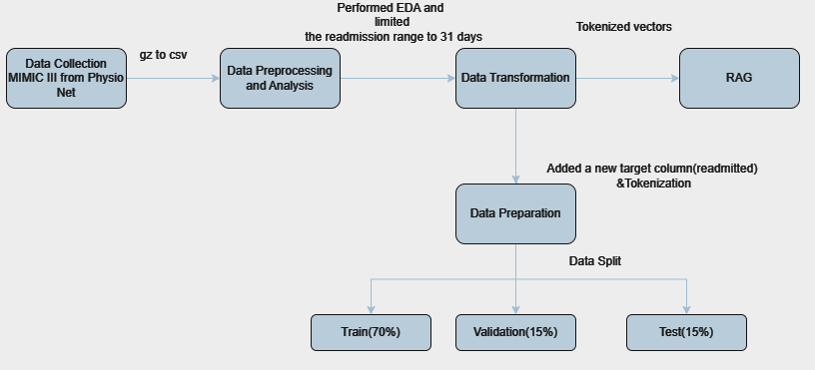
Data Process

Slide 11
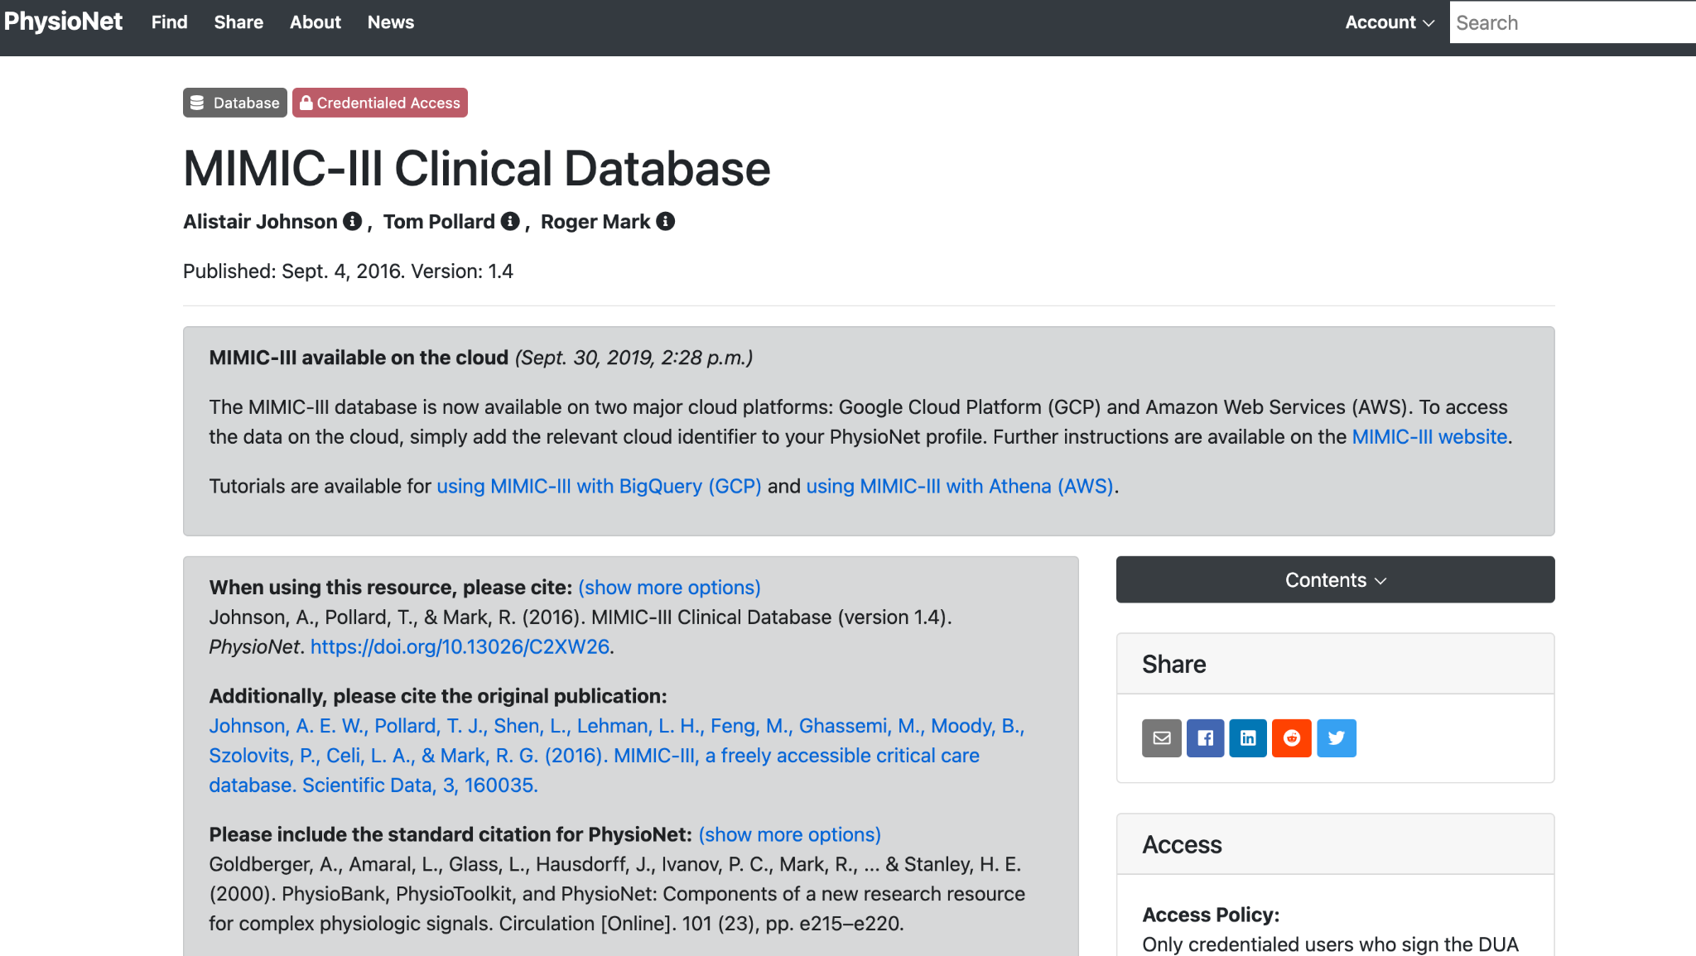
Data Collection
Data Source: MIMIC-III Database hosted on PhysioNet Website
Content: Hospital admission and discharge records, clinical notes, vital sign measurements, laboratory test results, procedures, medications, caregiver notes, imaging reports, mortality statistics.
Patient Identification: Each patient is identified by a unique SUBJECT_ID.
Admission Identification: Each hospital admission is assigned a unique HADM_ID.

Slide 12
Raw Datasets
Admissions
Noteevents
ROW_ID
SUBJECT_ID
HADM_ID
ADMITTIME
DISCHTIME
DEATHTIME
ADMISSION_TYPE
ADMISSION_LOCATION
DISCHARGE_LOCATION
INSURANCE
LANGUAGE
RELIGION
MARITAL_STATUS
ETHNICITY
EDREGTIME
EDOUTTIME
DIAGNOSIS
HOSPITAL_EXPIRE_FLAG
HAS_CHARTEVENTS_DATA
ROW_ID
SUBJECT_ID
HADM_ID
CHARTDATE
CHARTTIME
STORETIME
CATEGORY
DESCRIPTION
CGID
ISERROR
TEXT

Slide 13
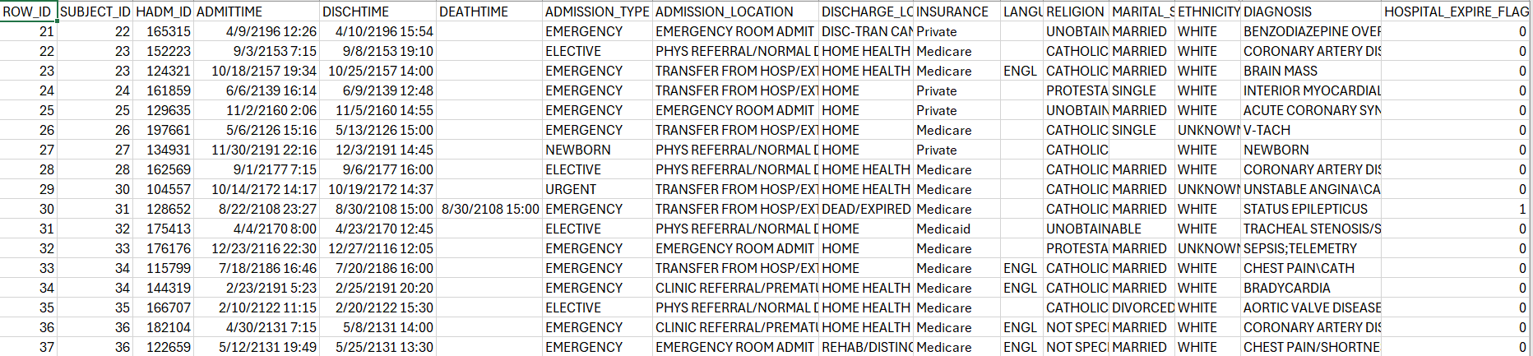
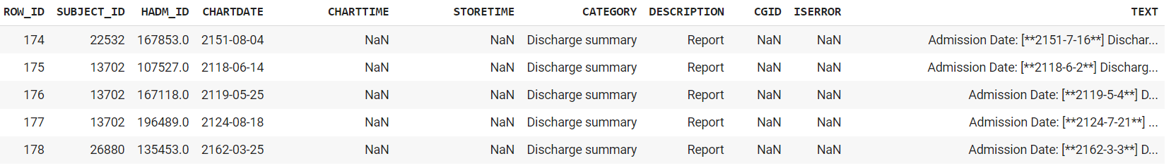
Raw Samples
Admission
Admissions
Noteevents

Slide 14
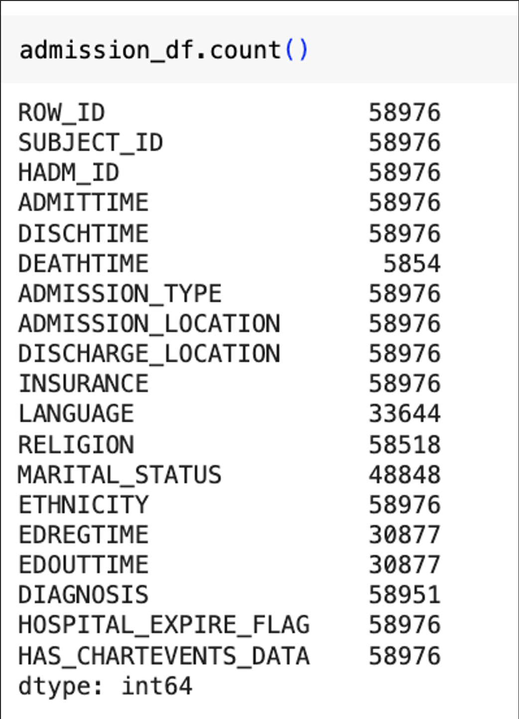
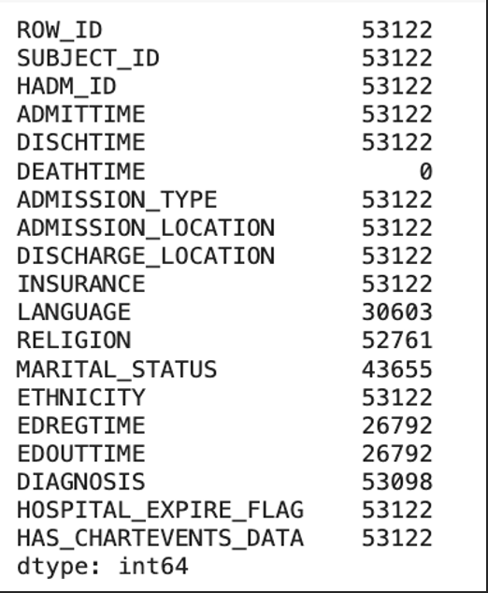
Data Preprocessing (Admissions)
Null value check (Remove deaths)
Before
After

Slide 15
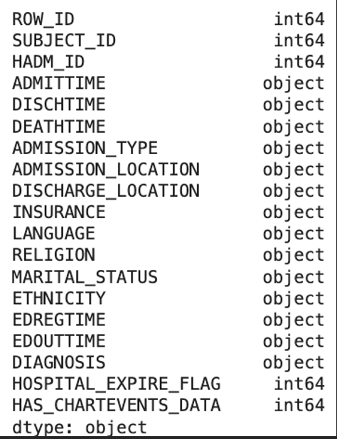
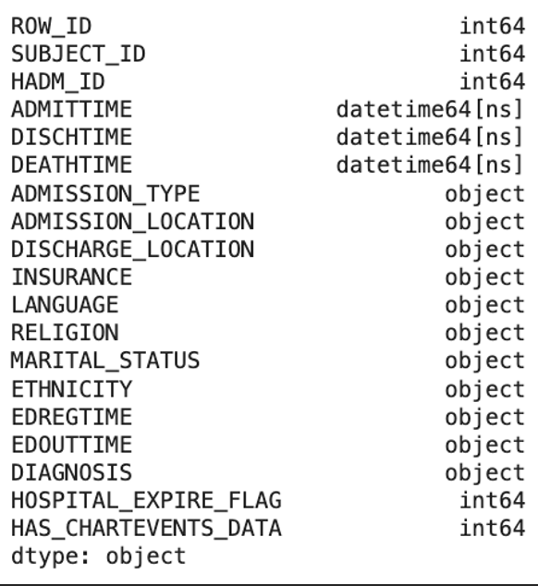
Data Preprocessing (Admissions)
Data Type conversion
Initial Data Types
Final Data Types

Slide 16
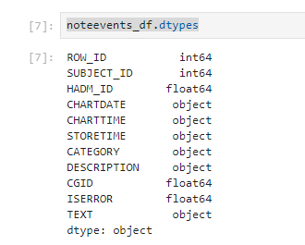
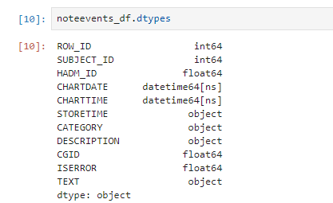
Data Preprocessing (Noteevents)
Data Type conversion
Concatenate the TEXT on Subject_ID
Initial Data Types
Final Data Types

Slide 17
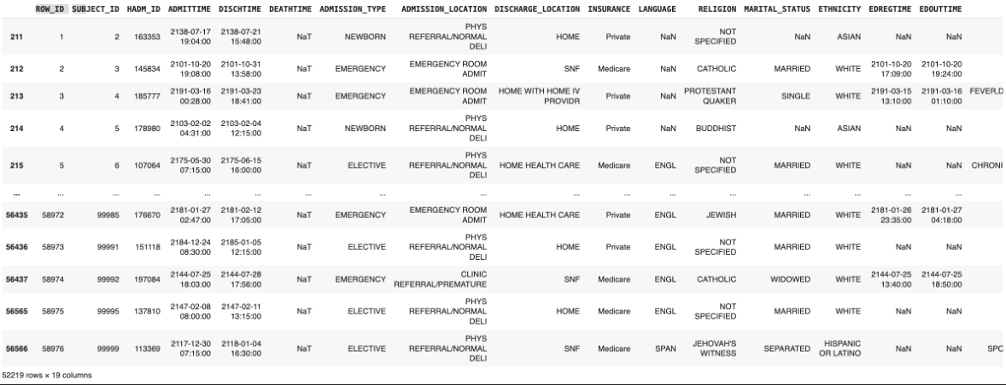
Data Transformation
Sort admissions dataframe on Subject_ID and Admittime

Slide 18
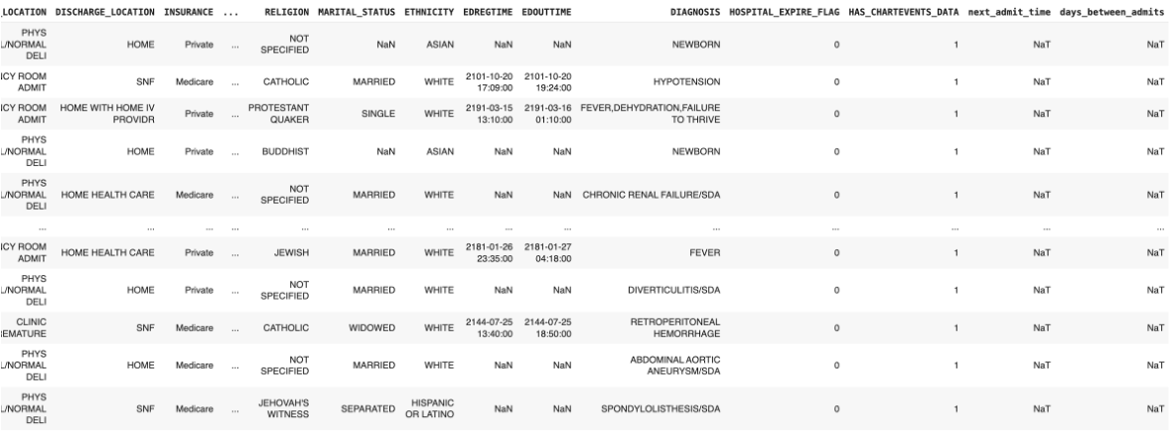
Data Transformation
Get next admission date (next_admit_time)
Calculate days until next admission (days_between_admits)

Slide 19
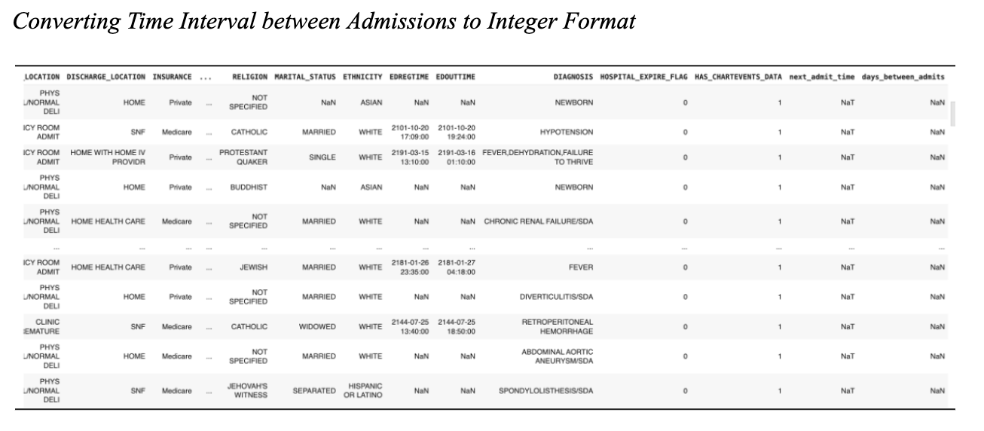
Data Transformation

Slide 20
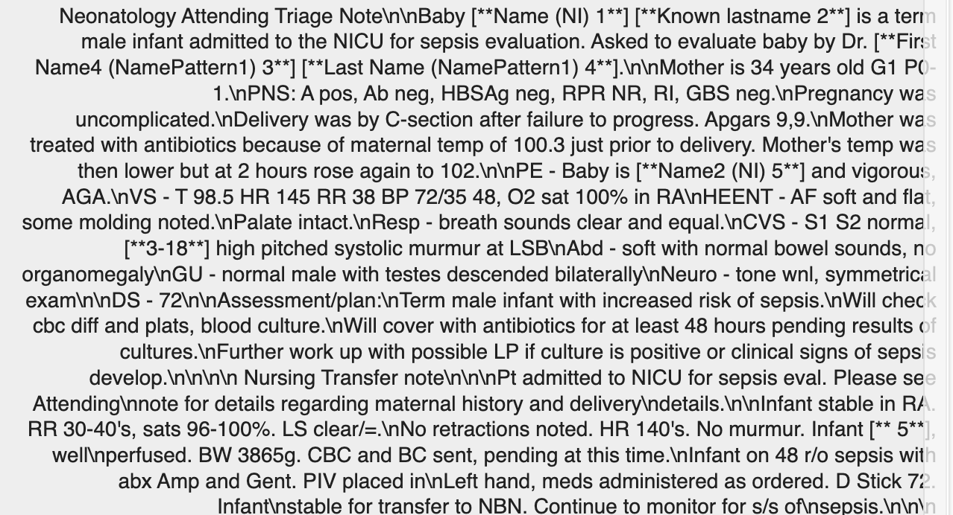
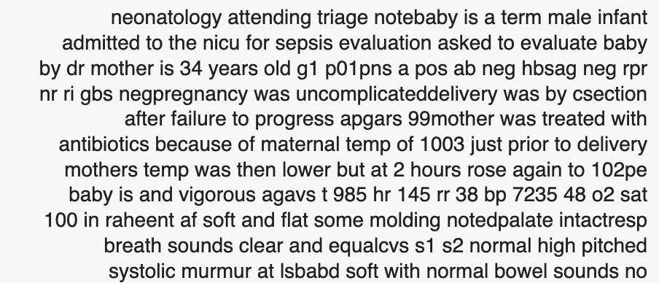
Data Transformation (Clinical Text)
Lowercasing the text and removing special characters contribute to improved text standardization
Before
After

Slide 21
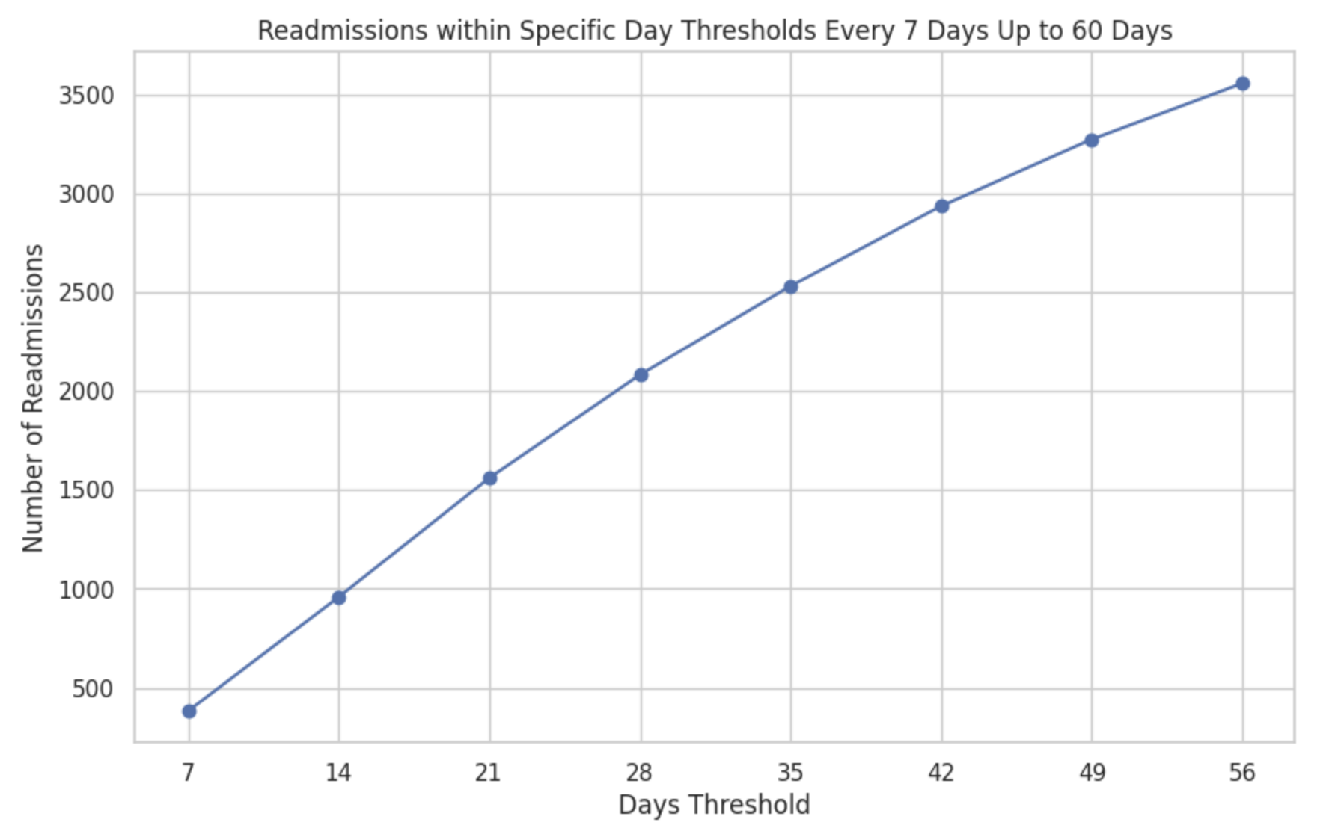
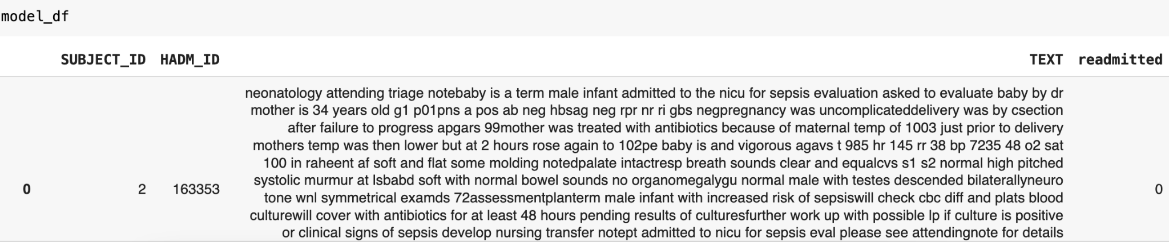
Considered readmitted if readmission is within 31 days.
Created a target column readmitted
Merged both datasets admissions data and clinical text to a final dataframe.

Slide 22
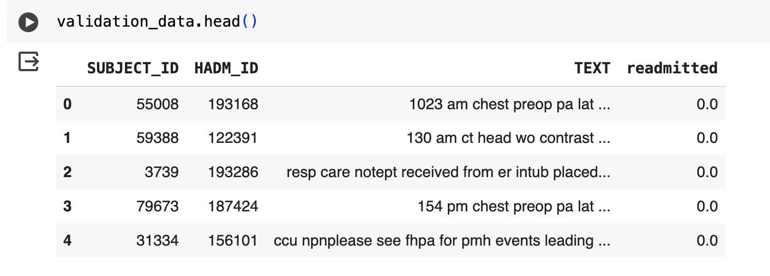
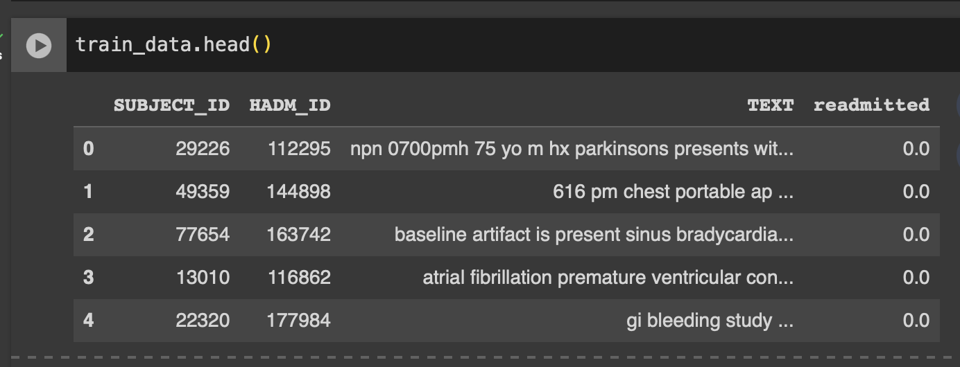
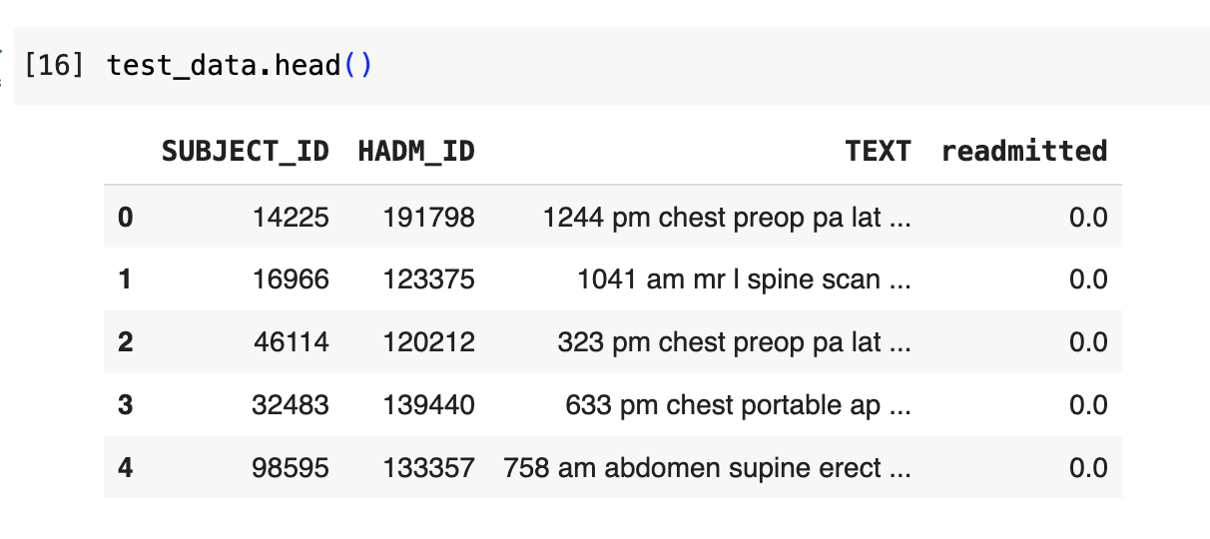
Data Preparation

Slide 23
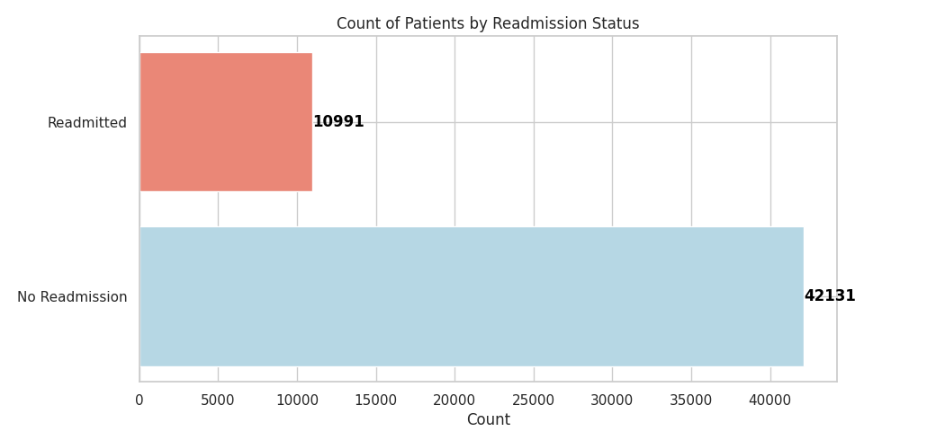
Data Analytics Techniques
Count of Patients by Readmission Status

Slide 24
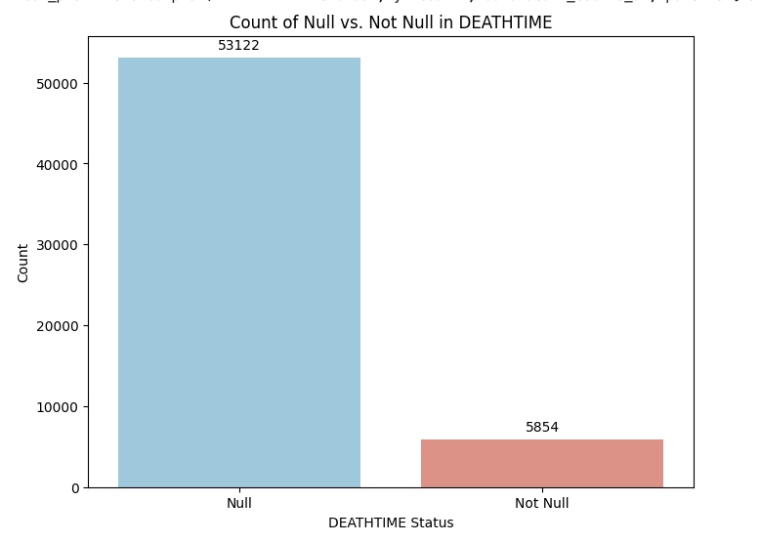
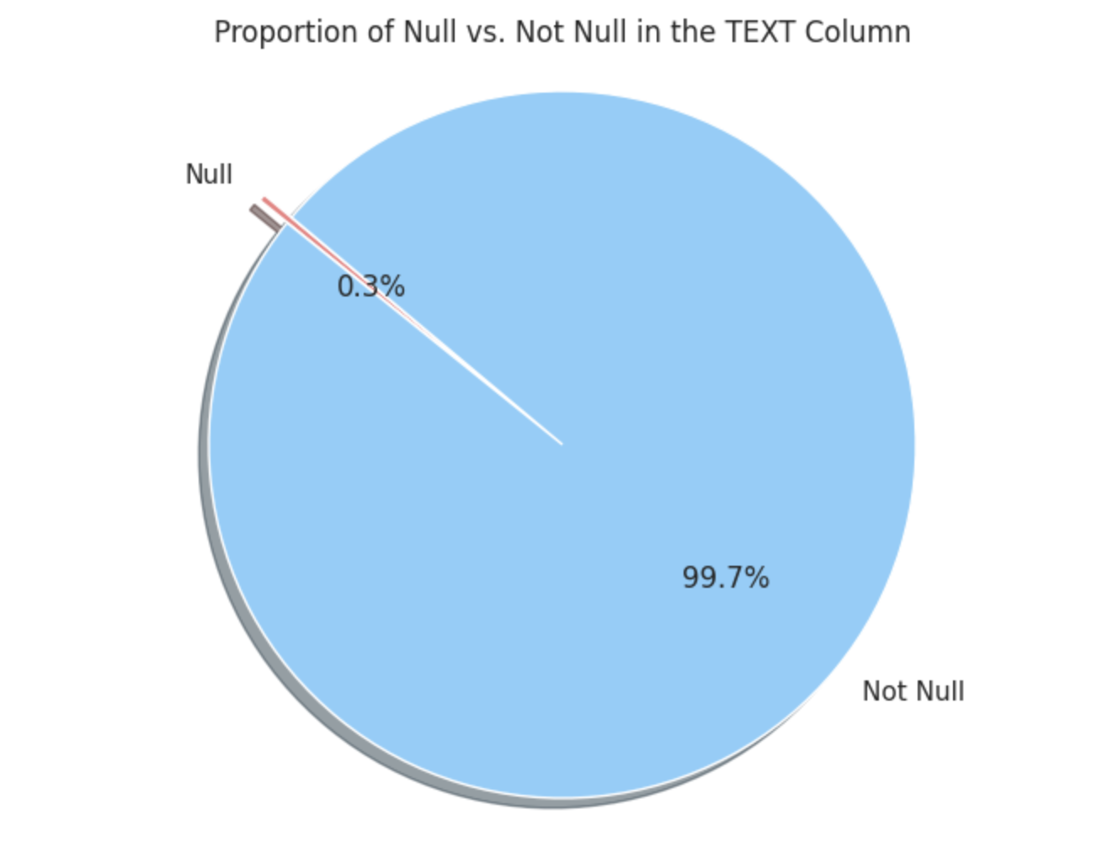
Data Analytics Techniques
A bar graph representing the number of null values and not null values in death_time column
Pie Chart representing the null values in the text column to omit them

Slide 25
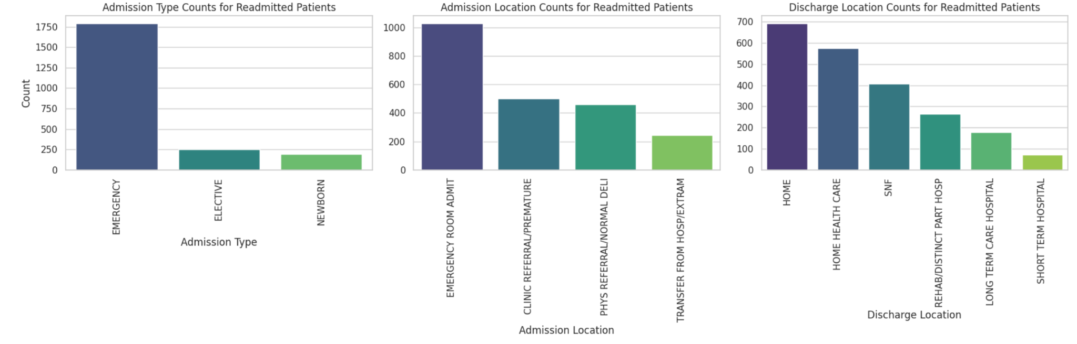
Data Analytics Techniques
Bar Chart showing the count of admission types
Bar Graph displaying discharge location counts for Readmitted patients
Bar Graph showing Admission location for readmission

Slide 26
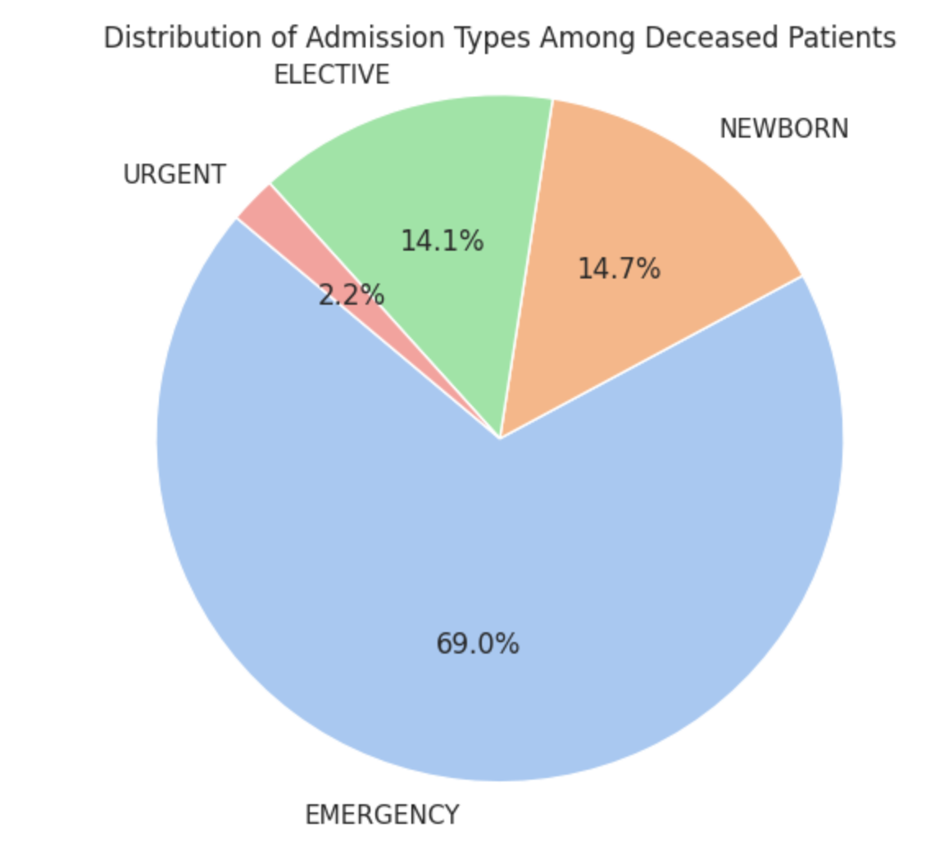
Data Analytics Techniques
Admission types presented in a pie chart

Slide 27
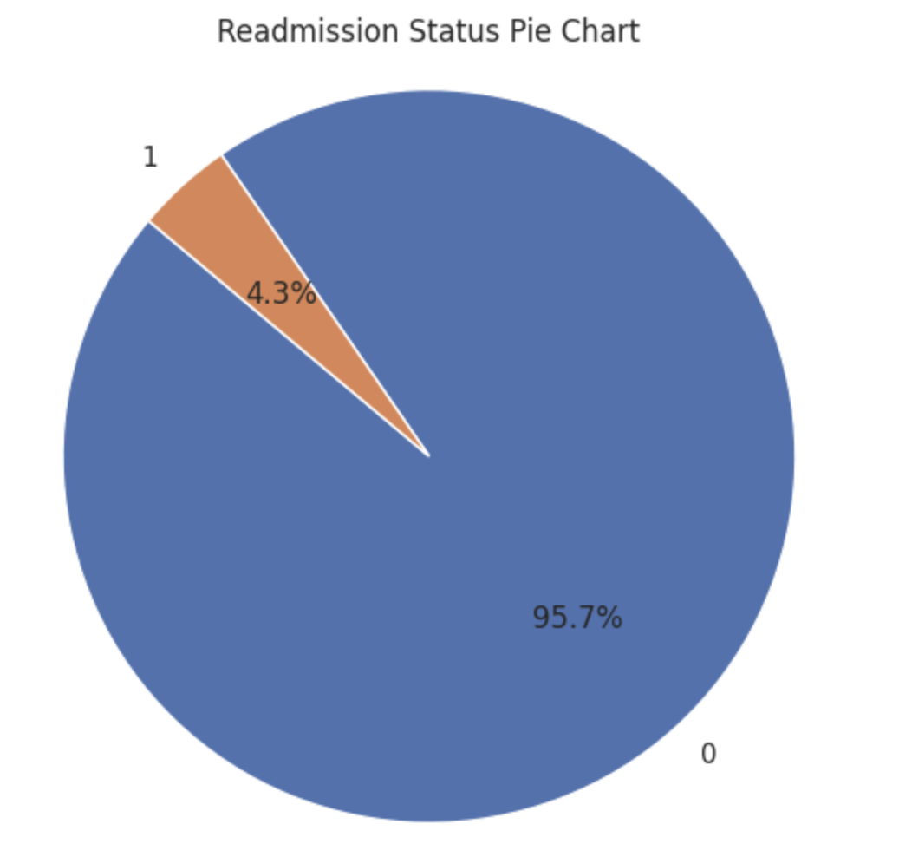
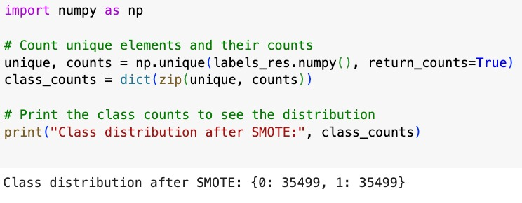
Unbalanced Dataset - Overcome using Sampling Technique
Pie Chart showing the distribution of target column based on the number of days which shows the data is imbalanced
As the dataset is imbalance we used SMOTE & Random Over Sampling technique to make it balanced

Slide 28

Model Selection
Clinical Bert
BioMistral
Mistral
Llama-2
Llama-3
Llama-3.1

Slide 29
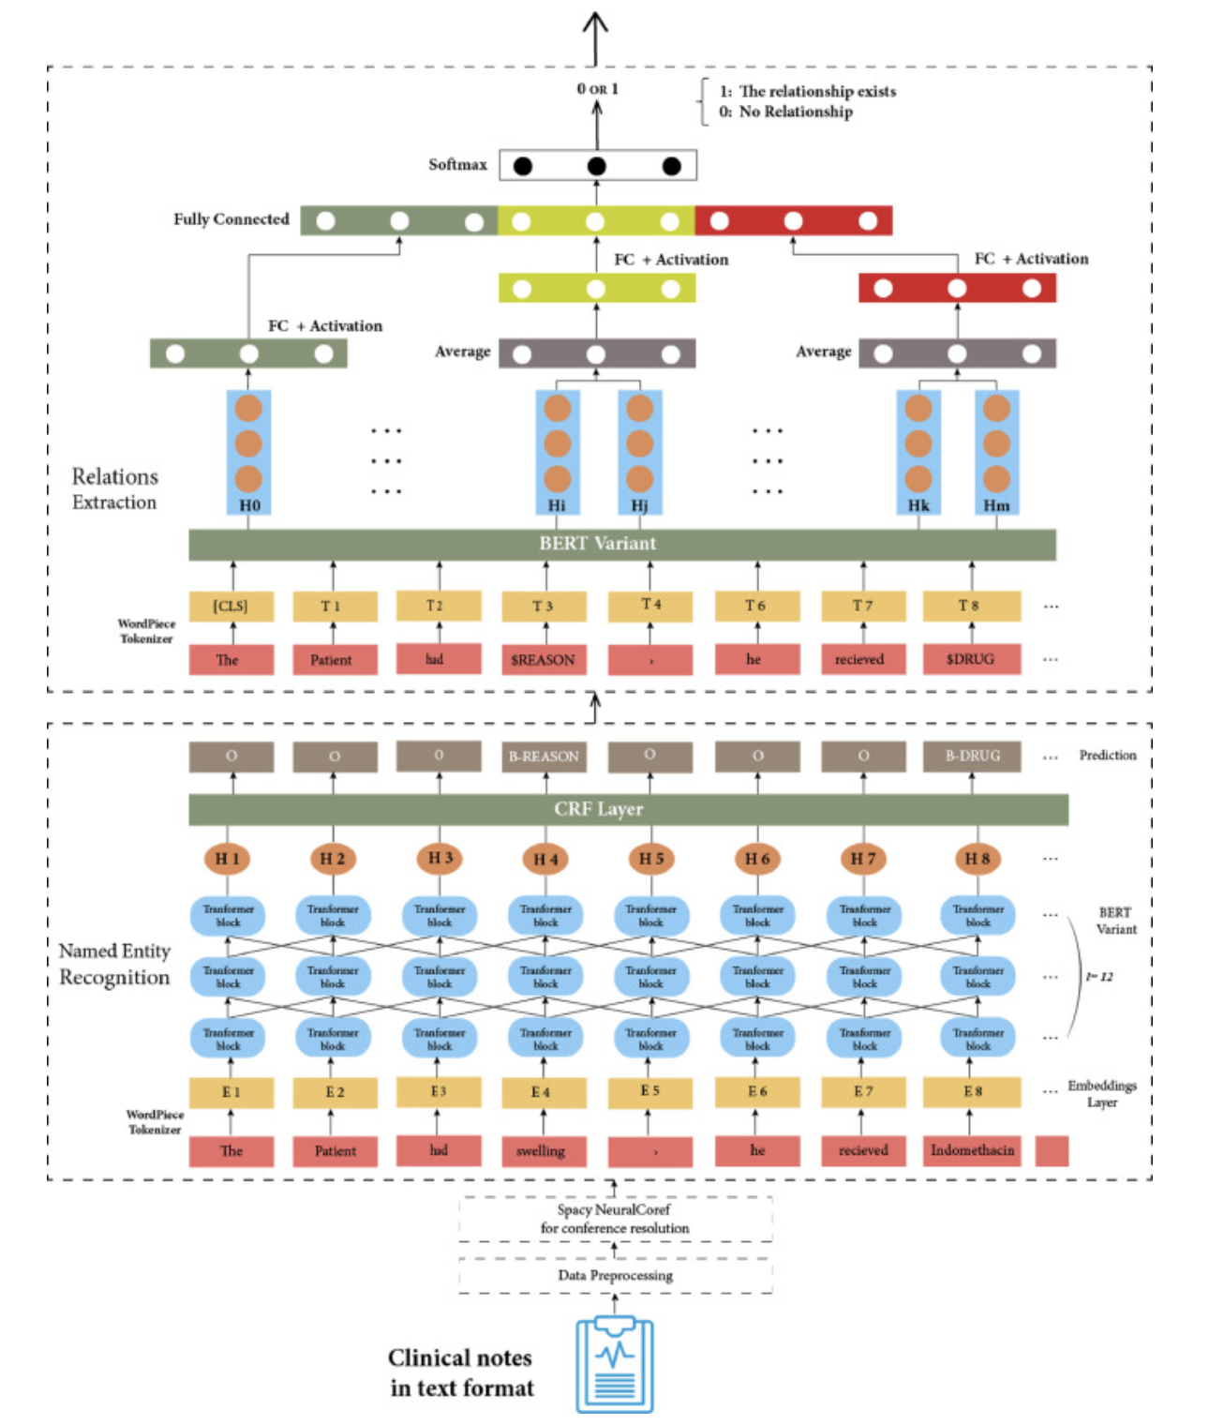
BERT Architecture
Notes:
SO Coming to clinical bert;
This is pretty much what we've implemented in our model as well
The upper component processes clinical notes through multiple transformer layers; from T1 to T8.
It has 3 processing paths
1. FC + Activation layer
2. Fc + Mixed Activation patterns
3. Soft max layer for final classification (Readmitted or not)
The Lower component is processed on NER (Named Entity Recognition) and its consists some Transformer based Embedding layers.
Ultimately; The whole architecture employs bidirectional processing

Slide 30
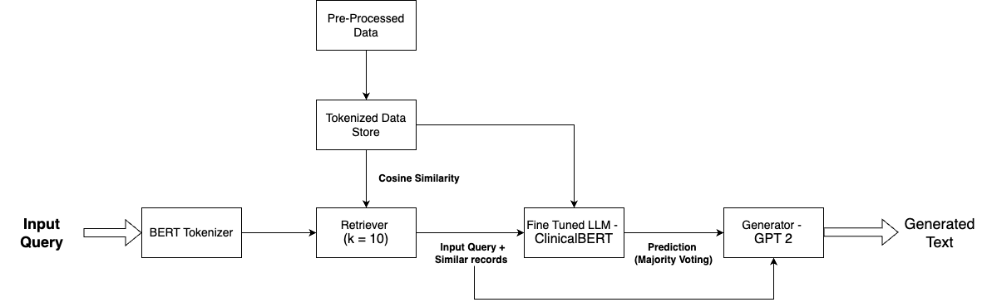
Modeling (ClincalBERT)

Slide 31
Model Innovation and Improvement
Clinical BERT Model
Enhancing Predictive Power: Incorporated GPT-2 transformers to enable text generation capabilities, overcoming Clinical BERT's limitation of handling only classification tasks.
Improved Contextual Insights: Generates predictions in text format, making results more interpretable and actionable for healthcare providers.
Notes:
Here in this model; We've incorporated GPT-2 Transformer to generate text output rather not to limit only for classification.

Slide 32
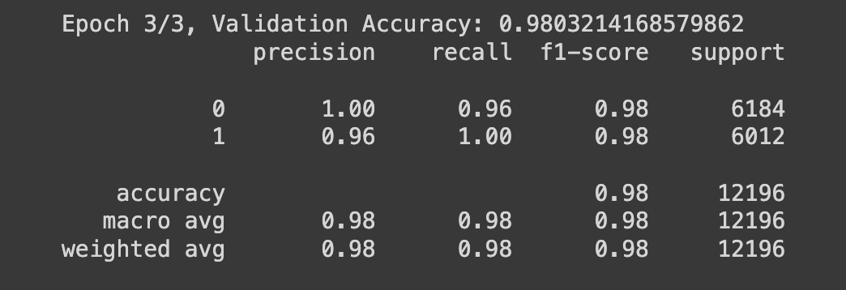
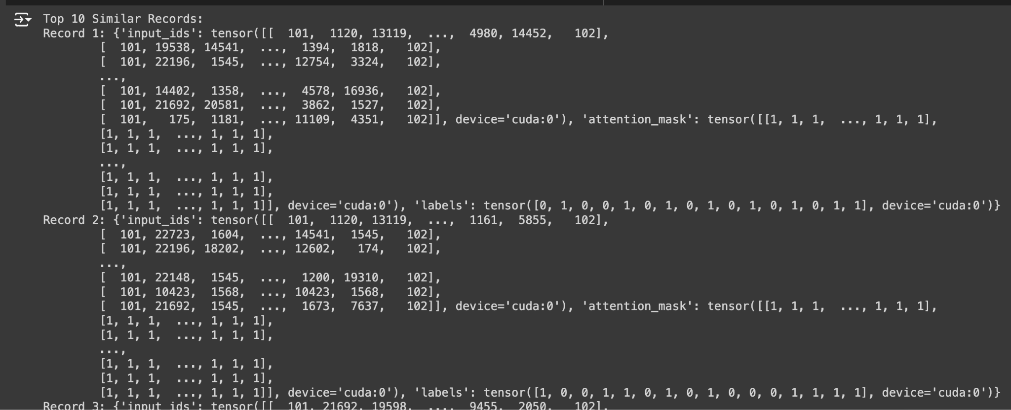

Clinical BERT Results
1] ClinicalBERT fine tuning
2 ] Retrieval Results of top 10 similar Records using Cosine Similarity
3 ] ClinicalBERT Prediction
4] GPT 2 Text generation using Retrieved Documents + Input Query + ClinicalBert Prediction

Slide 33
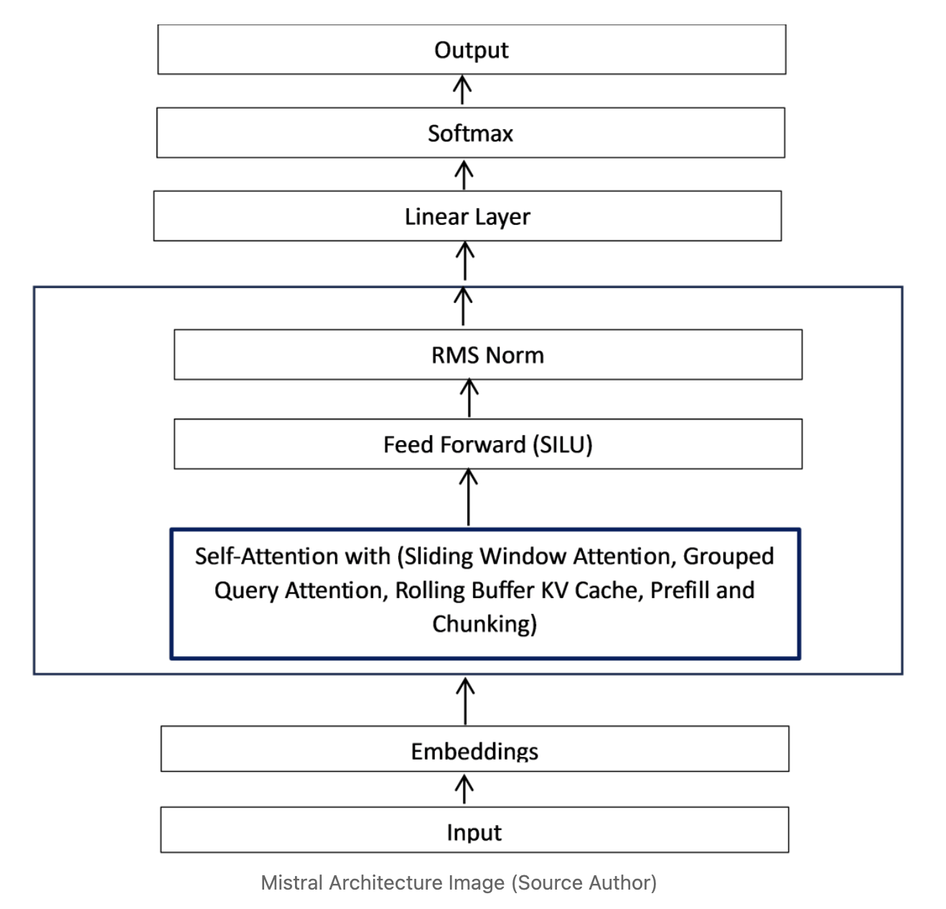
Mistral 7B Architecture
Notes:
Coming to mistral 7b; This is pretty much the architcture in the model; Initially we converted our text to suitable format using some sentence transformers to embedd the data and then we've used Faiss CPu to store the data in the vector DB. and then We build a RAG for Query Answering

Slide 34
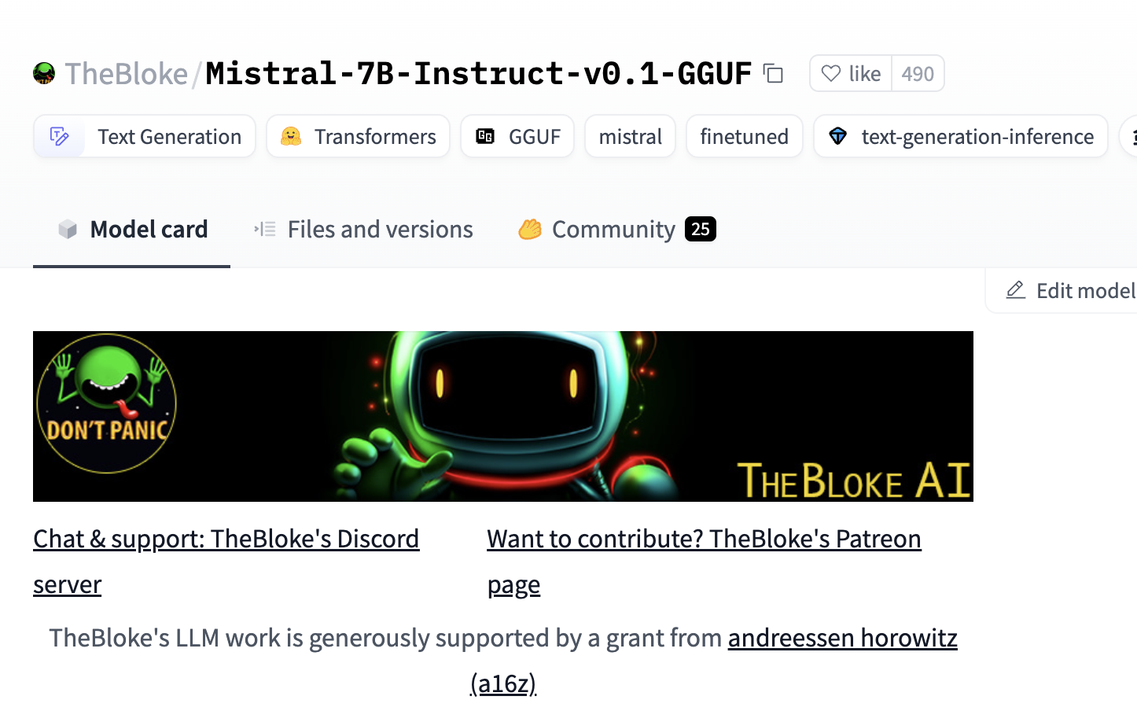
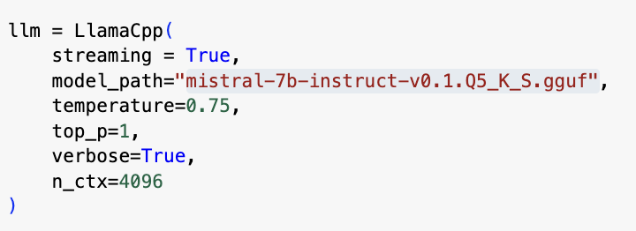
Mistral 7b (Contd..)
Notes:
The Framework used is LLama CPP LLAma Inedex here All the temperature; Top_P values were tested with different values to have good variability in the answer that suits best for the question.

Slide 35
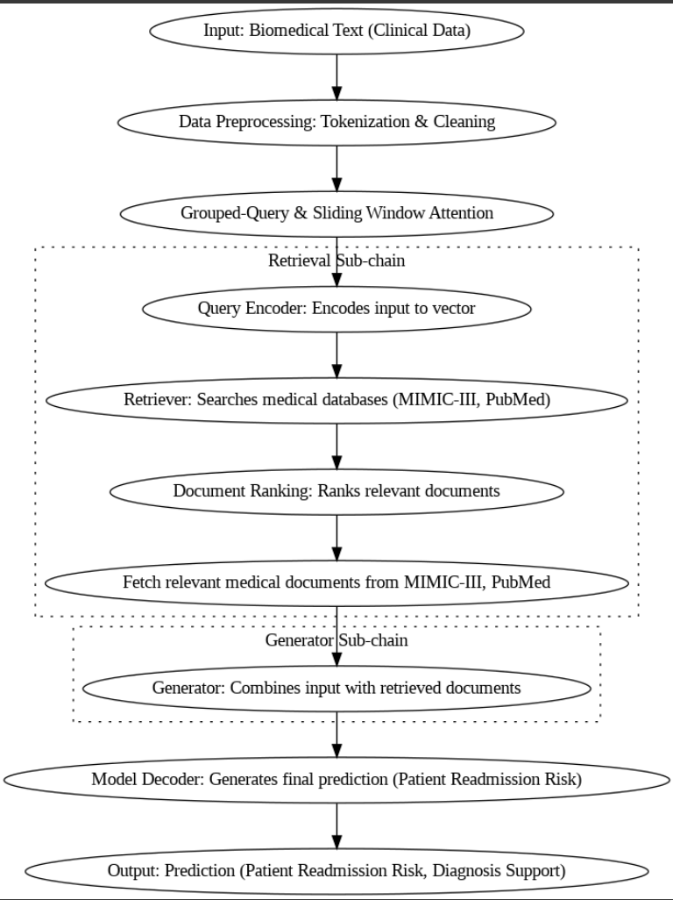
BioMistral
Notes:
Biomistral is similar to mistral We've pretty much used the same architecture that we've used for Mistral Architecture and rag building. The only advantage is that; We need not finetune it as it has already been finetuned with Mimic 3 and Pubmed datasets which is a good thing to know for getting better results.

Slide 36
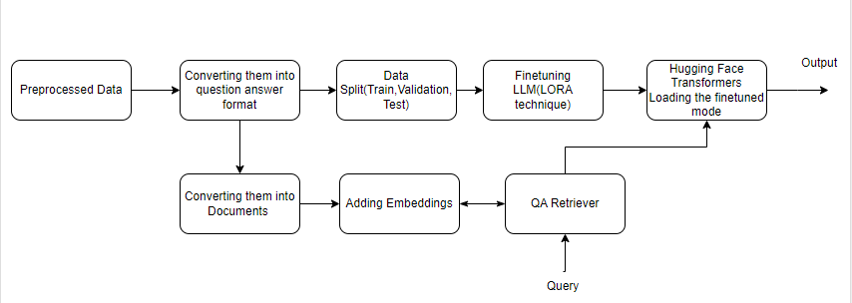
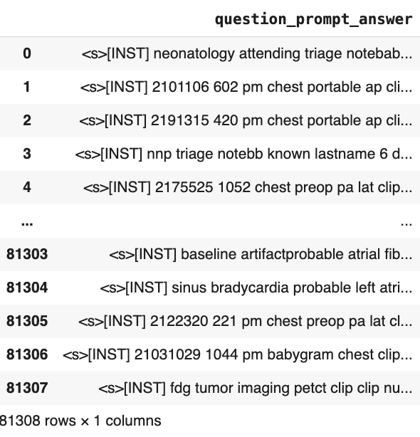
Model Innovation (Llama 2)
Notes:
SO coming to LLama series We've Used BAAI embedding Beijing Association of Artificial Intelligence

Slide 37
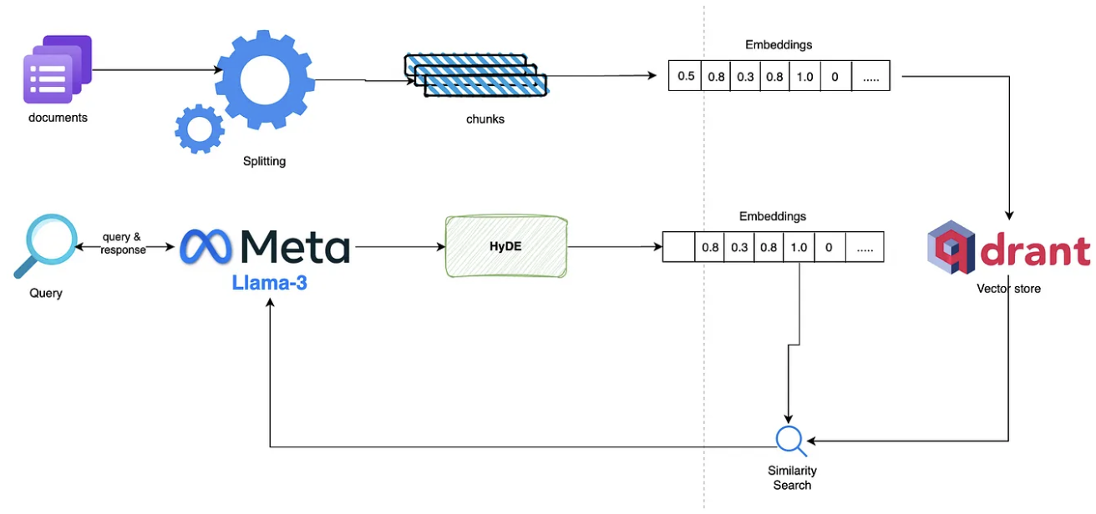
Model Selection (Llama 3 and Llama 3.1)
Notes:
•The system begins with document input, represented by purple document icons
•Documents undergo a splitting process through processing gears
•The split documents are converted into chunks
•These chunks are transformed into numerical embeddings (shown as number sequences)
•The embeddings are stored in Qdrant vector database for efficient retrieval
•
•
•User queries enter through a search interface
•Queries are processed by Meta's Llama-3 model
•The HyDE (Hypothetical Document Embeddings) component generates embeddings for the query
•These embeddings are used for similarity search against the stored document embeddings
•The system performs a similarity search to find relevant matches

Slide 38
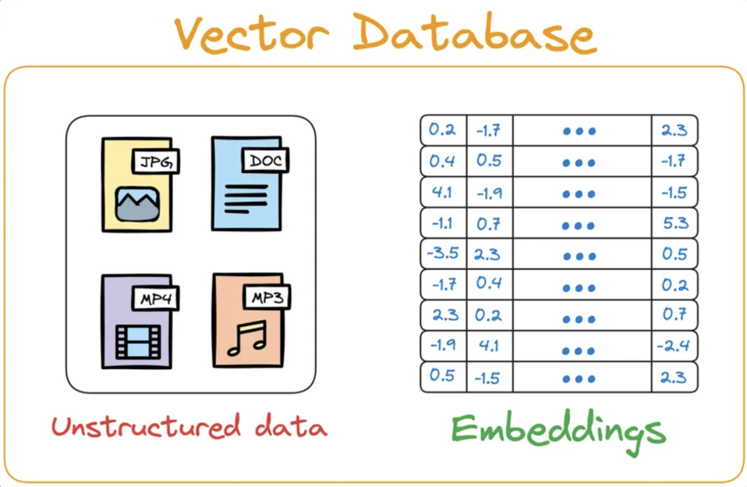
Efficient Vector DB’s Used
Vector Databases and Their Use Cases
FAISS (CPU)
Used for: Mistral 7B and LLama 2
Reason: Lightweight, efficient, and optimized for smaller-scale deployments; ideal for models with moderate retrieval demands.
Chroma DB
Used for: BioMistral
Reason: Tailored for managing long biomedical texts; provides robust scalability and specialized support for extensive document retrieval.
Qdrant
Used for: LLama 3 and LLama 3.1
Reason: High-performance retrieval with vector search optimized for complex queries and larger datasets, ensuring fast and accurate results.
Notes:
Different vector databases were used for efficient retrieval:
FAISS (CPU): Used for Mistral 7B and Llama 2, ideal for models with moderate retrieval demands.
Chroma DB: Used for BioMistral, tailored for managing long biomedical texts.
Qdrant: Used for Llama 3 and Llama 3.1, optimized for complex queries and larger datasets.

Slide 39
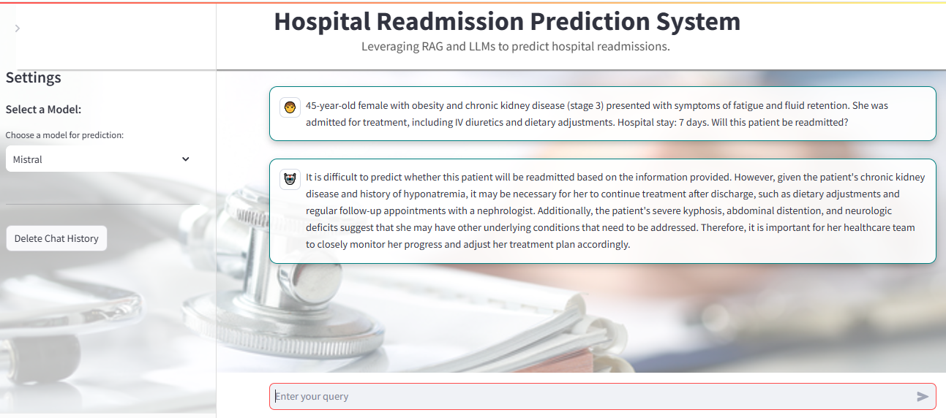
Mistral 7B Results
Notes:
Mistral Says Not Readmitted Cause

Slide 40
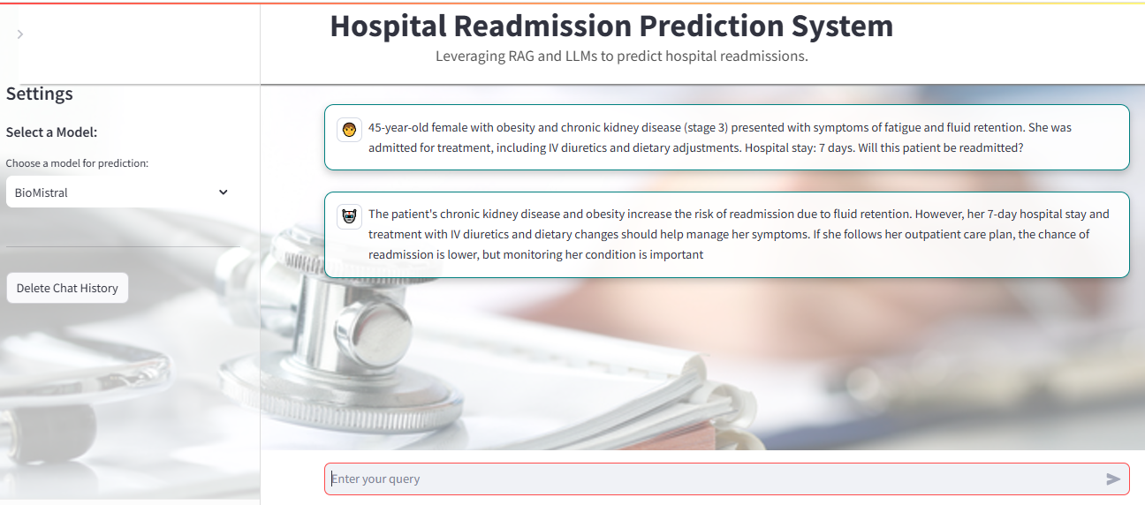
BioMistral 7b Results UI

Slide 41
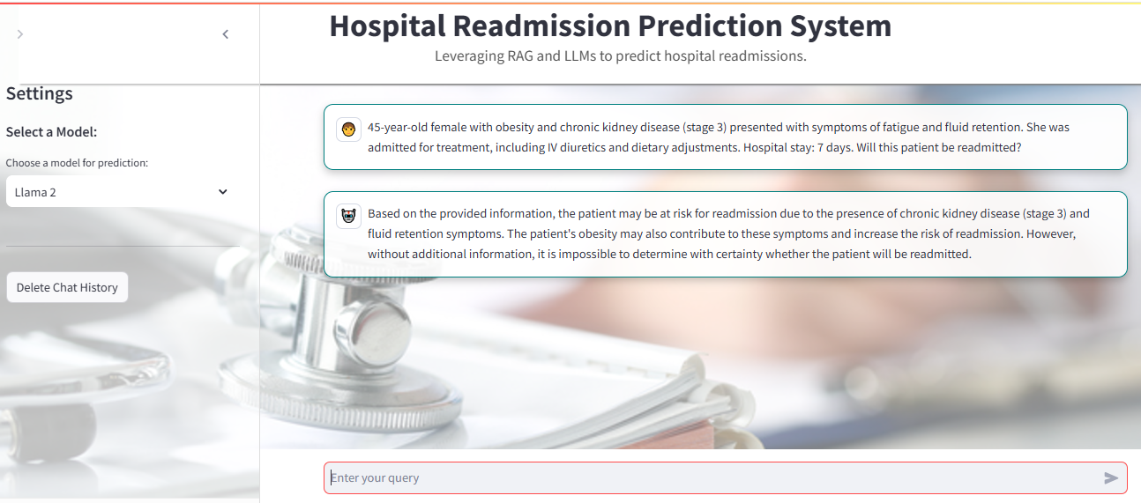
Model Results (Llama 2)

Slide 42
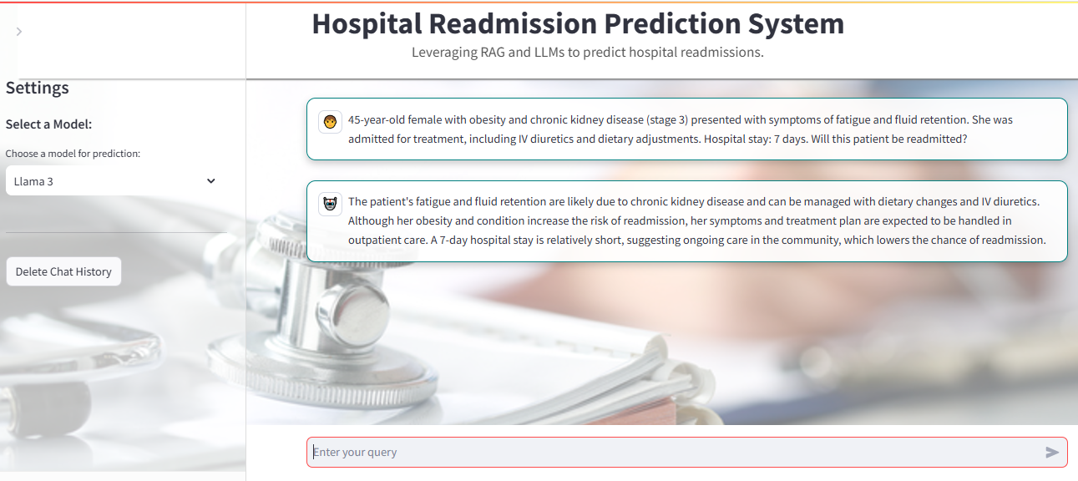
Model Results (Llama 3)

Slide 43
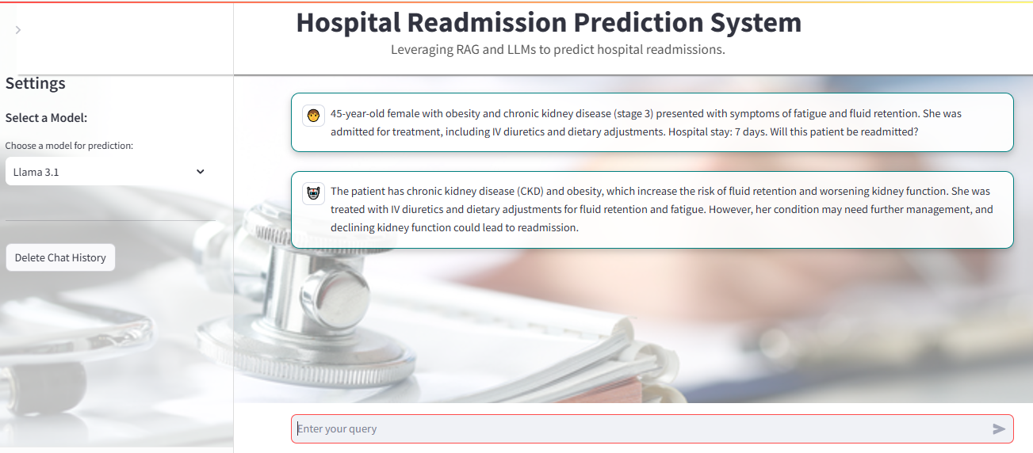
Model Results (Llama 3.1)

Slide 44
Evaluation Metrics Considered
Prediction Metrics
F1 Score: Computes the average of precision and recall
Accuracy : System's ability to predict the outcome correctly
Precision: Accuracy of positive predictions in system
Recall: It tells how well model finds the positive instances in the data
AUROC: Metric that summarises how well the model can find the positive terms without including the negative ones
Text Generation Eval Metrics
BERT Score: It is used to identify the similarity between the machine translation generated text and reference based text.It considers the cosine similarity in the text
ROUGE Score : It measures the similarity in text generated and reference by comparing the overlapping n-grams in summaries by considering the percentage
METEOR Score: Meteor score also calculates the similarity by taking the chunks of the sentence where ordering also matters a lot

Slide 45
Model Results Comparison
RAG Eval metrics
Metric | Clinical_BERT
Precision | 0.96
F1 - Score | 0.98
Accuracy | 0.98
AUPRC | 0.83

Slide 46
Model Evaluation Metrics Results ( All LLM models), Text generation
Metric | Mistral 7B (Without Fine-tuning) | BioMistral (Already Fine-tuned) | Llama 2 (Without Fine-tuning) | Llama 3 (Without Fine-tuning) | Llama 3.1 (Without Fine-tuning)
F1 Score | 0.83 | 0.83 | 0.90 | 0.49 | 0.78
BERT Score | Precision: 0.86 Recall: 0.89 F1: 0.87 | Precision: 0.88 Recall: 0.89 F1: 0.89 | Precision: 0.8124 Recall: 0.8508 F1: 0.8812 | Precision: 0.87 Recall: 0.86 F1: 0.85 | Precision: 0.86 Recall: 0.90 F1: 0.88
ROGUE | ROUGE-1: 0.20 ROUGE-2: 0.05 ROUGE-L: 0.15 ROGUE-Lsum:0.15 | ROUGE-1: 0.29, ROUGE-2: 0.10, ROUGE-L: 0.22, ROUGE-Lsum: 0.22. | ROUGE-1: 0.237, ROUGE-2: 0.0607, ROUGE-L: 0.1655, ROUGE-Lsum: 0.1677. | ROUGE-1 = 0.23 ROUGE-2 = 0.07 ROUGE-L = 0.09 ROUGE-Lsum = 0.18 | ROUGE-1 = 0.239 ROUGE-2 = 0.07 ROUGE-L = 0.18 ROUGE-Lsum = 0.18
METEOR | 0.26 | 0.33 | 0.25 | 0.28 | 0.28

Slide 47
Model Evaluation Metrics Results ( All LLM models), Text generation
LLaMa Series Fine-tuned
Metric | Mistral 7B (Without Fine-tuning) | BioMistral (Already Fine-tuned) | Llama 2 (Fine-tuned) | Llama 3 (Fine-tuned) | Llama 3.1 (Fine-tuned)
F1 Score | 0.83 | 0.83 | 0.93 | 0.52 | 0.81
BERT Score | Precision: 0.86 Recall: 0.89 F1: 0.87 | Precision: 0.88 Recall: 0.89 F1: 0.89 | Precision: 0.8334 Recall: 0.8508 F1: 0.8812 | Precision: 0.88 Recall: 0.87 F1: 0.87 | Precision: 0.87 Recall: 0.91 F1: 0.89
ROGUE | ROUGE-1: 0.20 ROUGE-2: 0.05 ROUGE-L: 0.15 ROGUE-Lsum:0.15 | ROUGE-1: 0.29, ROUGE-2: 0.10, ROUGE-L: 0.22, ROUGE-Lsum: 0.22. | ROUGE-1: 0.258, ROUGE-2: 0.0823, ROUGE-L: 0.2055, ROUGE-Lsum: 0.1987 | ROUGE-1 = 0.24 ROUGE-2 = 0.09 ROUGE-L = 0.097 ROUGE-Lsum = 0.19 | ROUGE-1 = 0.24 ROUGE-2 = 0.08 ROUGE-L = 0.19 ROUGE-Lsum = 0.1895
METEOR | 0.26 | 0.33 | 0.29 | 0.285 | 0.287

Slide 48
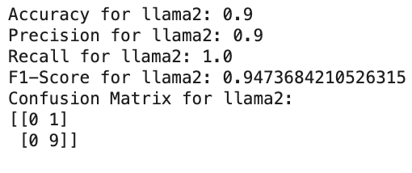
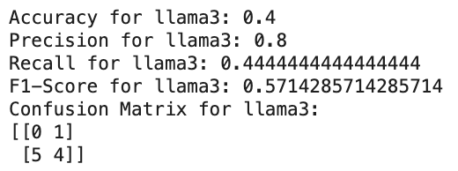
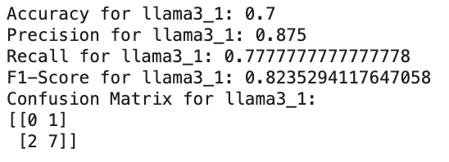
Model Evaluation Metrics Results (Llama Series Fine-tuned), Binary Prediction
Llama 2
Llama 3
Llama 3.1

Slide 49
Why these Evaluation Metrics ?
Relevance to Clinical Texts: Metrics like BERT Score and ROUGE ensure the generated text aligns semantically and contextually with reference material, critical for extracting actionable insights from clinical narratives.
Balancing Class Imbalance: Metrics such as AUPRC and F1 Score are well-suited for handling imbalanced datasets like hospital readmissions, where positive readmission cases are fewer.
Precision Matters in Healthcare: High precision is crucial to minimize false positives, which could lead to unnecessary interventions or missed opportunities for care.
Practicality and Interpretability: These metrics are widely recognized in NLP and classification tasks, ensuring robust, reproducible, and interpretable results.

Slide 50
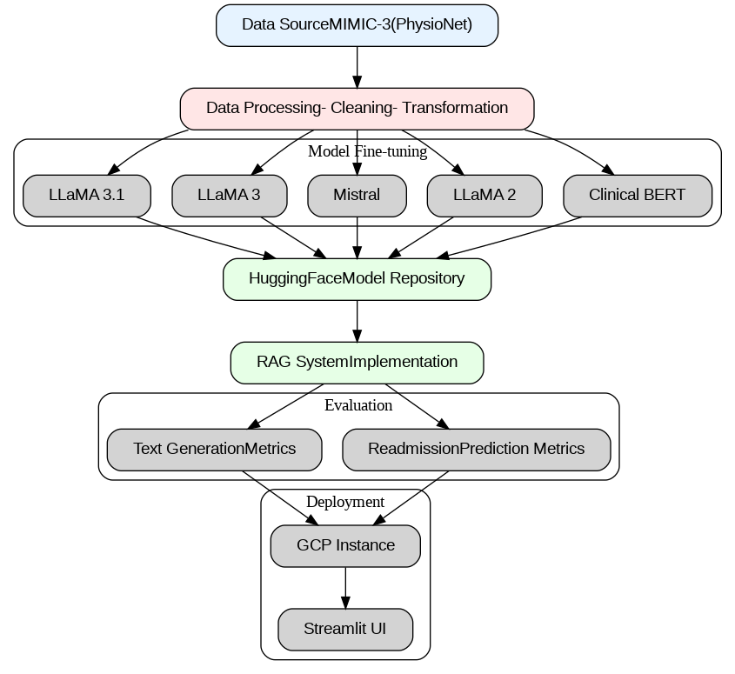
System design
Architecture

Slide 51
Achievements
Implementation of Multiple Language Models
Clinical BERT, Mistral, Llama, and GPT models tailored for hospital readmission predictions.
Data Acquisition and Efficient Storage
Leveraged MIMIC-III dataset using AWS S3 for scalable data storage and processing.
Advanced Similarity Search & Embedding Techniques
Utilized BAAI embeddings with Sentence Transformers for improved semantic similarity.
Integrated Hugging Face libraries for embedding generation and model fine-tuning.
Efficient Model Deployment & Orchestration
Used FAISS indexing with Llama CPP, LlamaIndex, and LangChain for modular and efficient query processing.
Deployed models using Ollama and other lightweight frameworks to optimize resource usage.
User Interface Development
Created an interactive Streamlit UI for model selection, enhancing user accessibility and clinical predictions.

Slide 52
Constraints
Challenges in Data Acquisition and Filtering
Issues with accessing and cleaning MIMIC-III data for ICU admissions.
Computational Limitations
Large model sizes required tensor optimizations for GCP deployment.
Hardware Requirements
ClinicalBERT deployment needed GPU resources for effective performance.
Latency in Response Times
Delays due to integrating GPT models impacted user experience.
High Infrastructure and Maintenance Costs
Significant expenses for cloud storage and GPU usage on GCP.

Slide 53
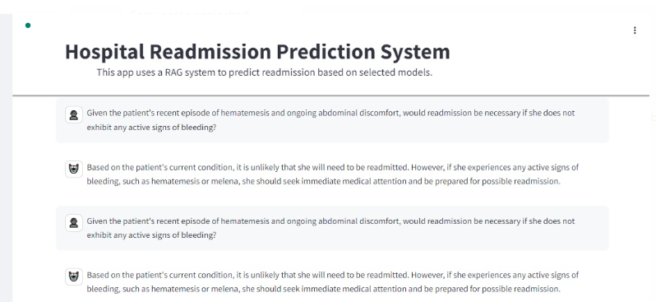
Evaluating the correctness of the model Consistency

Slide 54

Evaluating the correctness of the model Token & contextual Reliability

Slide 55
Query response Time
Clinical Bert Average Response Time : 1.3 Sec Bio_Mistral Average Response Time : 6.34 Sec
Mistral 7b Average Response Time: 13.45 Sec
Llama 2 , Llama 3 and Llama 3.1 takes an average of 20- 25 sec

Slide 56
AI Explainability

Slide 57


System Visualization Eval. metrics Analytics (Clinical Bert)

Slide 58



System Visualization Eval. metrics Analytics (Mistral 7B)

Slide 59



System Visualization Eval. metrics Analytics (Bio_Mistral)

Slide 60



System Visualization Eval. metrics Analytics (Llama 2)

Slide 61




System Visualization Eval. metrics Analytics (Llama 3)

Slide 62



System Visualization Eval. metrics Analytics (Llama 3.1)

Slide 63

Web based System Design and Architecture

Slide 64

Intelligent Solution Development
Improving Model Performance (Finetuning)

Slide 65

Improving Model Performance (Reranking)

Slide 66
Interactive User Interface
Interactive Features:
The chatbot interface enables clinicians to input patient details and receive real-time predictions on readmission likelihood. Features like model selection dropdowns and query response history enhance usability. Aesthetic Design:
The UI follows modern design principles, ensuring it is clean, responsive, and accessible. Color schemes and fonts were chosen to ensure readability and reduce strain during prolonged use.
Streamlined Functionality:
From input validation to memory management (e.g., chat history storage), the interface is designed to foster trust and engagement with healthcare providers.

Slide 67
Interactive User Interface

Slide 68
System Demo and Testing
https://drive.google.com/file/d/1dxGCy2DfpZI6HjKJSIgW0KHE-EWW9Jvg/view?usp=drive_link
Group directory : https://drive.google.com/drive/folders/0AI_5fdQHvvlmUk9PVA

Slide 69
Thank You

